Slide 1

Music Suggestion System
By Sarah Grossheim

Slide 2

About Project
When listening to music on shuffle, Apple Music and Spotify only suggests music that is in the same genre of the current song you are listening to.
However, I like to listen to music based off the current mood that I am in.
So, I have created a music suggestion system that outputs three songs based on the mood that the user selected.

Slide 3

How I did this:
First, I created a CSV file full of songs from my Apple Music library. This included the song title, artist, genre, and the corresponding mood that I thought that it conveyed.
This took a very long time because I have a lot of songs. The CSV file has 1526 different songs.
Keep in mind that this suggestion system will only work for me because each song could convey a different mood to me than it would a different person.
There are 8 different moods that I chose for this project:
Angry
Breakup
Happy
Lonely
Love
Party
Sad
Vibey

Slide 4

After I created the CSV file, I used sci-kit-learn's label encoder to fit the labels for the genre and mood columns to numbers to be used for the model.
This is how each mood got encoded:
Mood:
0 – Angry
1 – Breakup
2 - Happy
3 – Lonely
4 – Love
5 – Party
6 – Sad
7 – Vibey
* Notice that they were encoded in alphabetical order.

Slide 5

Project Mishaps
I started this project thinking that I wanted to use a clustering algorithm. So, I first tried to use the Kmeans algorithm.
This clustering algorithm did not give the output I wanted.
During the process of me using this algorithm, my computer crashed, and I completely lost the CSV file that I had made. So, I had to spend a couple more hours creating it again.

Slide 6
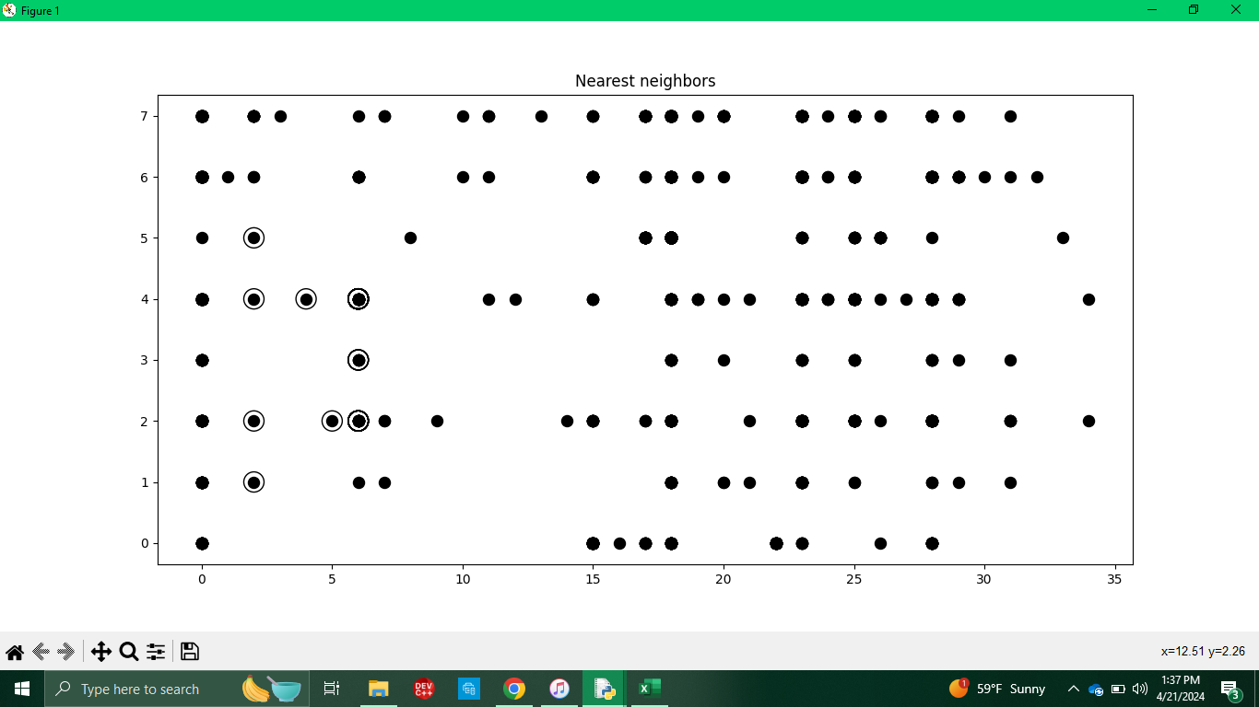
K Nearest Neighbors Algorithm
After having several different mishaps, I found the perfect algorithm...
Before:
Input:
Genre: 6
Mood 3

Slide 7
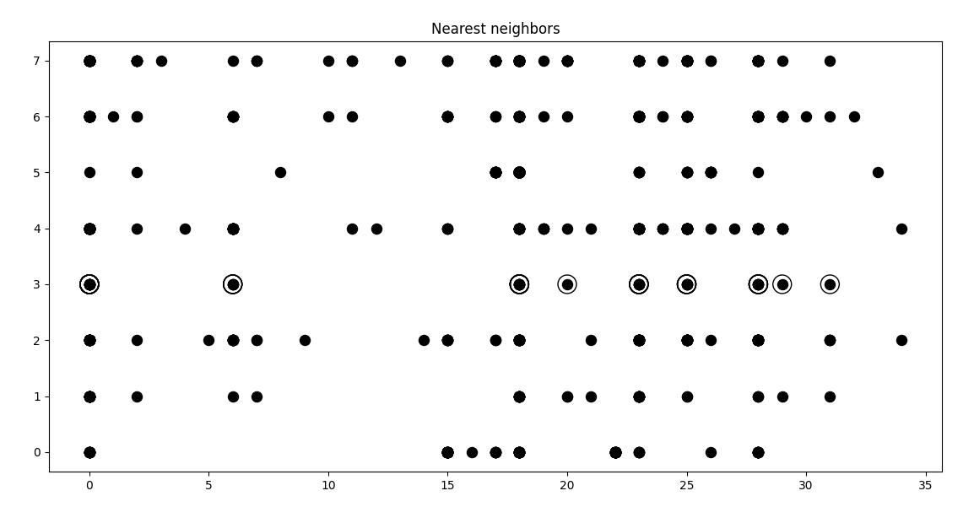
K Nearest Neighbors Algorithm
After:
Input:
Genre: 6
Mood 3

Slide 8
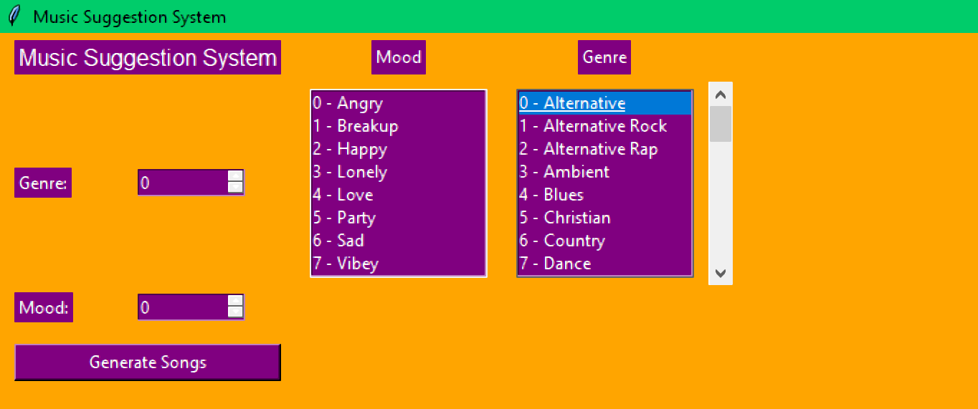
GUI

Slide 9
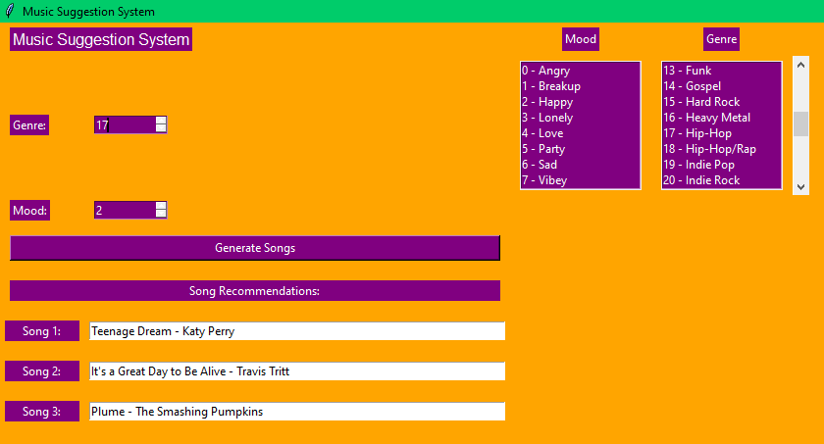

Slide 10
Original Idea
My original idea was to have the program output 3 songs of the same mood AND genre and if there wasn't 3 songs based on the mood and genre then to just output 3 songs of the same mood.
However, this didn't really work out. But the program will always output the same user selected mood!
The program has potential to output songs within the user selected genre, however, this doesn't always happen.
This is because I had to shuffle the list of songs because the program was only outputting songs in alphabetical order.

Slide 11
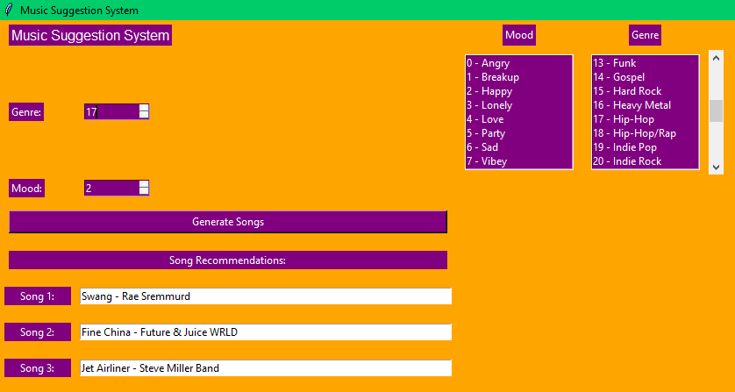

Slide 12
Thank you for listening!

